Slide 1
Dashboards, Learning by Example!

Slide 2
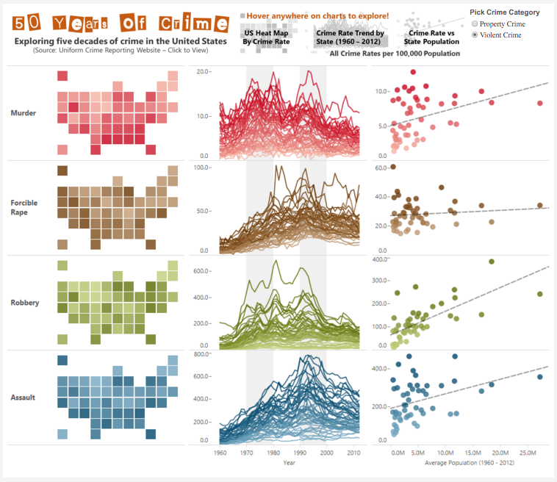
Shine Pulikathara
50 Years of Crime
✓
Image Based Title
✓
Interactivity
✓
Custom Chart Type
✓
How to Use
✓
Small Multiples
✓
Custom Colors
✓
Data Sourced
✓
Uses a Map
https://public.tableau.com/s/gallery/50-years-crime-us

Slide 3
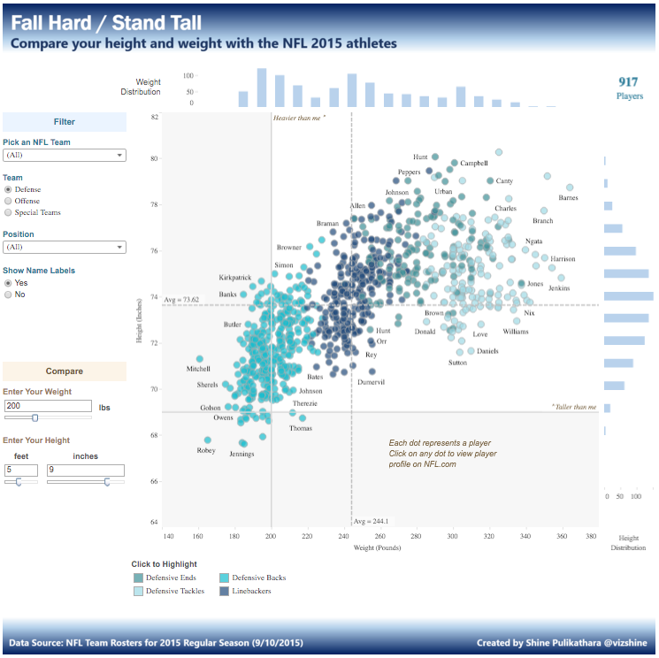
Shine Pulikathara
Fall Hard / Stand Tall
☢
Gradient
Title
Supporting
Charts
✓
Interactivity
✓
Reference Band
✓
How to Use
Custom Colors
✓
Data Sourced
https://public.tableau.com/profile/shine.pulikathara#!/vizhome/FallHardStandTall/FallHardStandTall

Slide 4
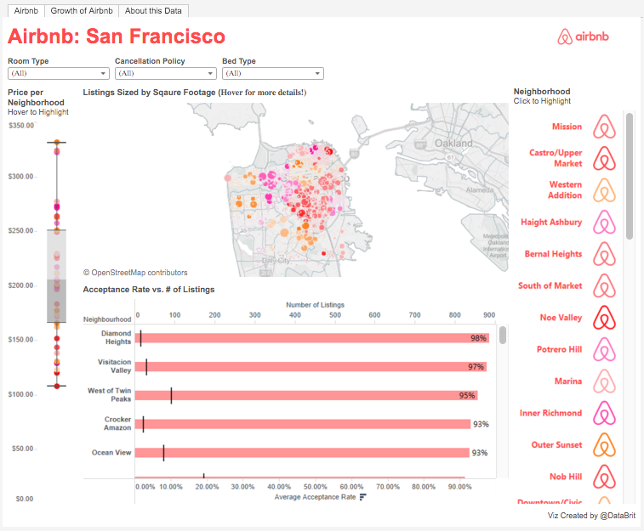
Brit Cava
Airbnb: San Francisco
✓
Interactivity
✓
How to Use
✓
Custom Color
✓
Custom Shapes
Supporting
Charts
✓
Data Sourced
✓
Uses a Map
https://public.tableau.com/s/gallery/airbnb-prices-san-francisco

Slide 5
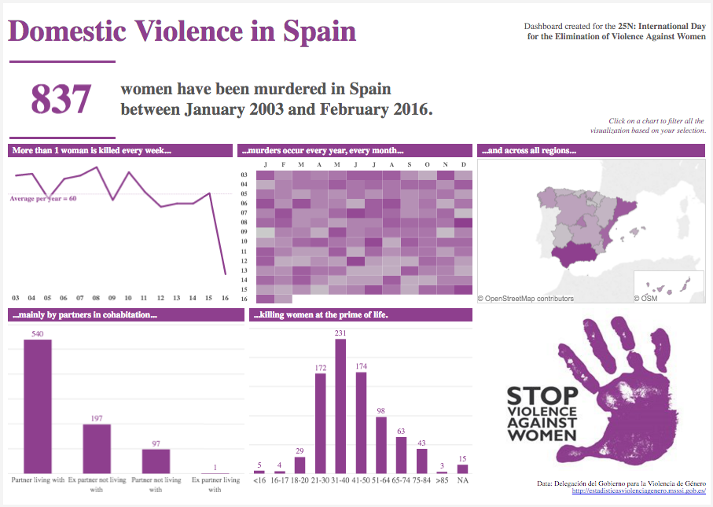
Pablo Saenz de Tejada
Domestic Violence in Spain
Big Number
Summary
✓
✓
How to Use
✓
Chart Variety
✓
Related Image
Custom Colors
✓
Data Sourced
https://public.tableau.com/s/gallery/domestic-violence-spain
✓
Uses a Map

Slide 6
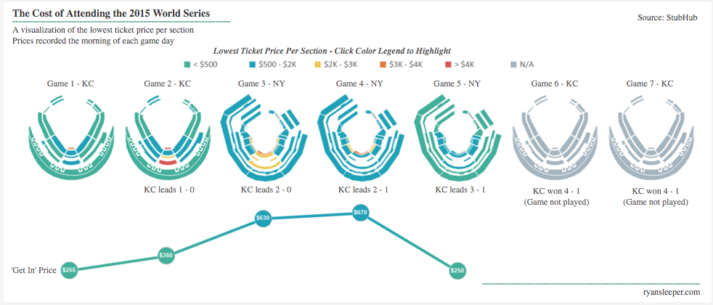
Ryan Sleeper
2015 World Series Ticket Prices
✓
Small Multiples
✓
Custom Colors
(cyclic palette)
✓
Custom Polygons
https://https://public.tableau.com/s/gallery/2015-world-series-ticket-prices
✓
Data Sourced
Fonts: Calibri, Calibri Light, Arial

Slide 7
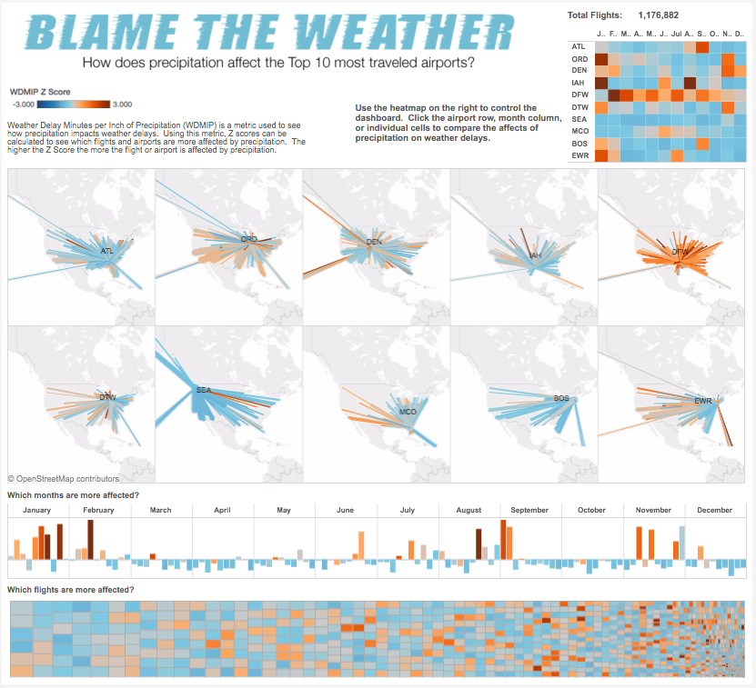
Matt Chambers
US Flights Delayed by Precipitation
✓
Image Based Title
✓
Small Multiples
✓
How to Use
✓
Mapping Paths
✓
Chart Variety
✓
Data Sourced
✓
Uses a Map
https://public.tableau.com/s/gallery/blame-weather-us-flight-delayed-precipitation

Slide 8
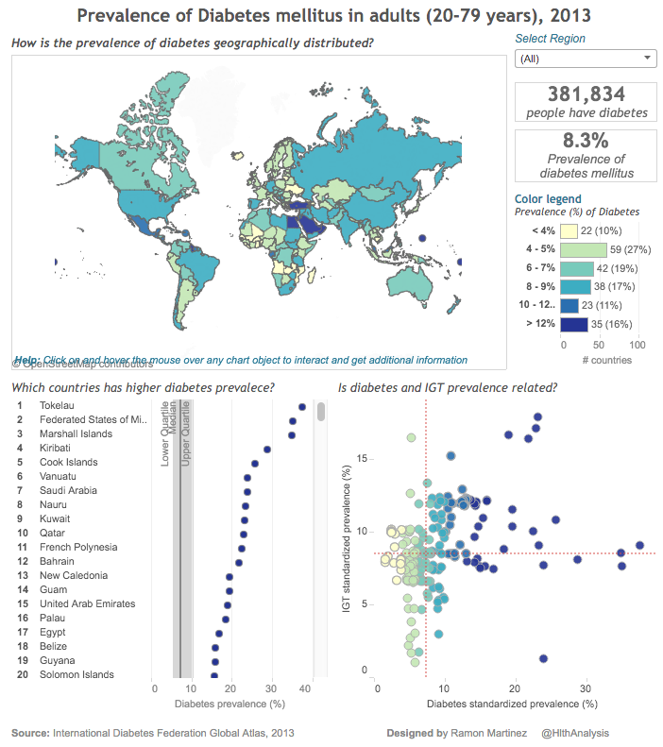
Ramon Martinez
Diabetes Prevalence
✓
Custom Colors
Big Number
Summary
✓
✓
How to Use
Reference Lines
✓
Chart Variety
✓
Data Sourced
Fonts: Trebuchet MS, Arial
✓
Uses a Map
http://public.tableau.com/views/Diabetes_2013/PrevalenceofDiabetesmellitusstdprev2013?:embed=y&:display_count=yes

Slide 9
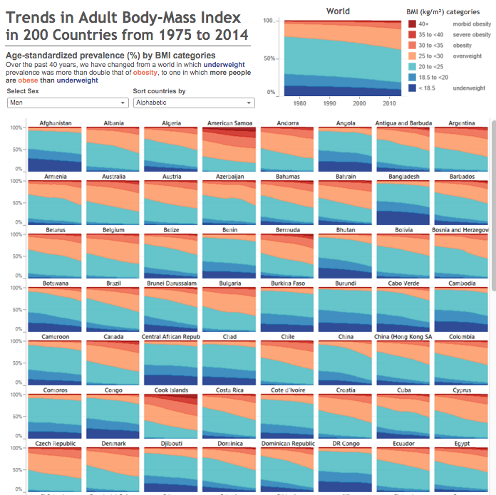
Ramon Martinez
Adult BMI in 200 Countries
✓
Storytelling
✓
How to Use
Interactivity
✓
Small Multiples
✓
Data Sourced
http://public.tableau.com/profile/ramon.martinez#!/vizhome/FourDecadesofPrevalenceinAdultBMI/TrendsinFourDecadesofBMIcategories

Slide 10
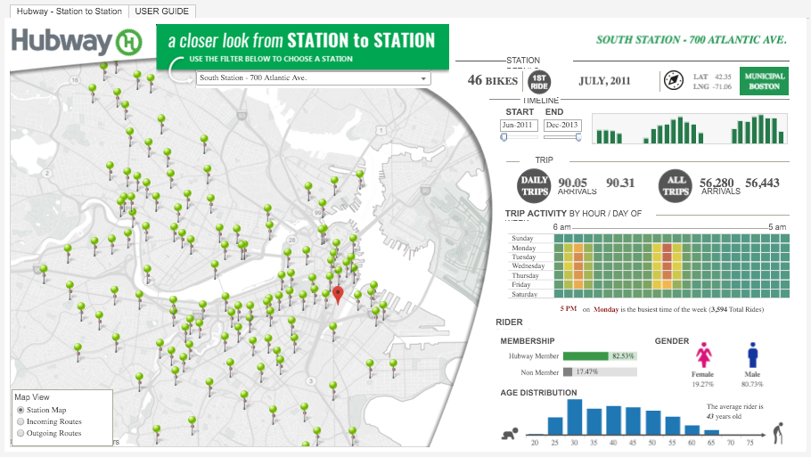
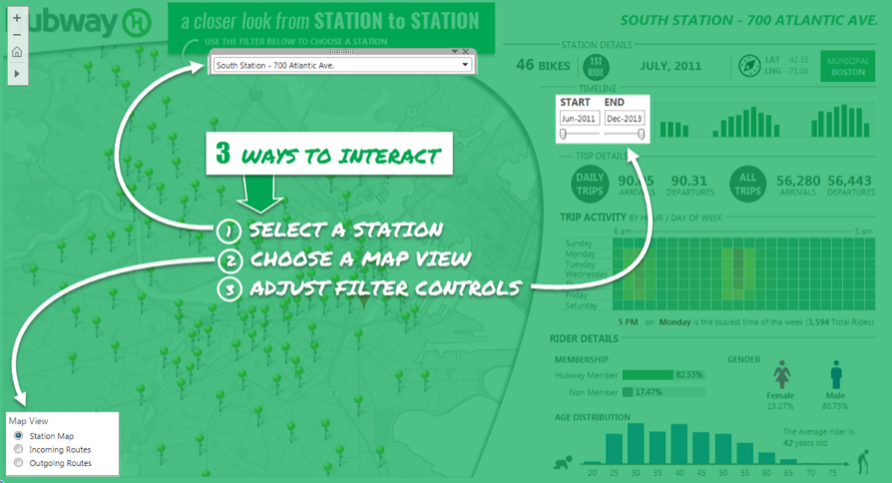
Brian Halloran
Boston Bike Share Trend
✓
Custom Images
Interactivity
✓
How to Use
✓
Chart Variety
✓
Data Sourced
https://public.tableau.com/s/gallery/boston-bike-share-trend
✓
Uses a Map

Slide 11
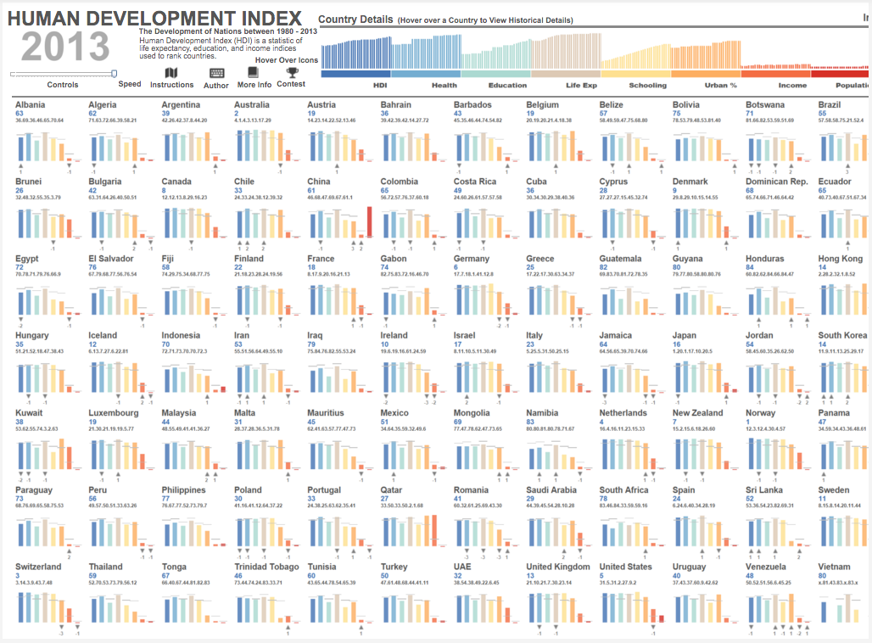
Russell Spangler
Human Development Index
✓
Interactivity
✓
How to Use
Custom Icons
Innovative
Notation
(Dual Axis at -0.15)
✓
✓
Small Multiples
https://public.tableau.com/s/gallery/human-development-index
✓
Data Sourced

